Slide 1
Support vector machine (SVM)

Slide 2
Support Vector Machine Overview
Developed at AT&T Bell Laboratories by Vapnik with colleagues in 90’s.
SVMs are one of the most robust prediction methods
SVMs can perform both linear and non-linear classification
Notes:
After people working on these questions 50 to 70 years later, there would not be any tricks left
Early 90s

Slide 3
Support Vector Machine
Find a linear hyperplane (decision boundary) that will separate the data
Notes:
How to do divide the positive examples from the negative examples
We draw a straight line
But which straight line is the question?

Slide 4
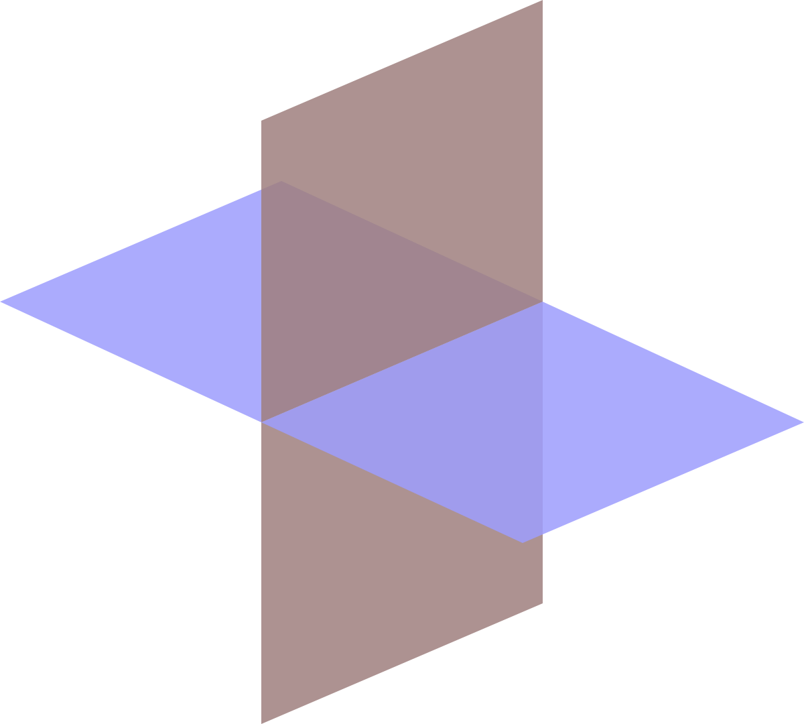
Hyperplane
In a p-dimensional feature space, a hyperplane is a flat affine subspace of hyperplane dimension p − 1.

Slide 5
Support Vector Machine
One Possible Solution

Slide 6
Support Vector Machine
Another possible solution

Slide 7
Support Vector Machine
Other possible solutions

Slide 8
Support Vector Machine
Which one is better? B1 or B2?
How do you define better?

Slide 9
Support Vector Machine
Find hyperplane that maximizes the margin => B1 is better than B2
Notes:
Widest street separate the green and white sample
The one that maximizes the distance to the closest data points from both classes. We say it is the hyperplane with maximum margin.
The rationale of maximum of the margin: better generalization errors than those with small margins, more robust to new data.
The SVM is a classifier that searches for a hyperplane with the largest margin. (example: two dimension case)

Slide 10
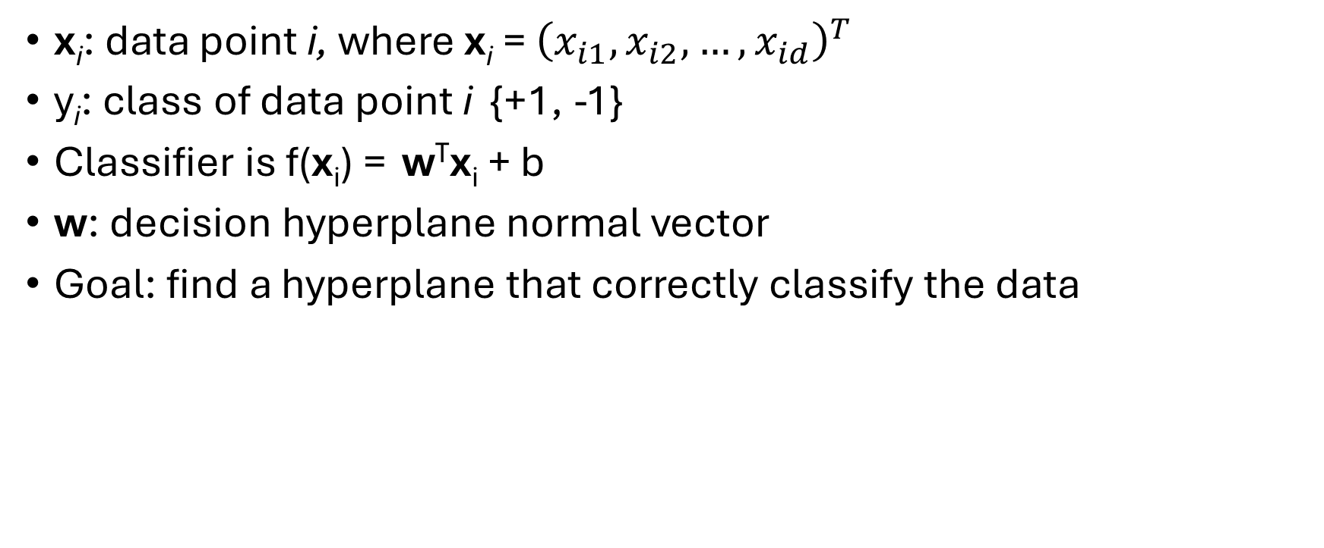
Notation
x_{i}: data point i, where x_{i} = ${\left(x_{i1}, x_{i2}, …, x_{id}\right)}^{T}$
y_{i}: class of data point i {+1, -1}
Classifier is f(x_{i}) = w^{T}x_{i} + b
w: decision hyperplane normal vector
Goal: find a hyperplane that correctly classify the data
Notes:
Y: class labels
The decision boundary of a linear classifier:

Slide 11
A “Fat” Hyperplane
ρ
Distance from example x_{i} to the separator is
Support vectors: cases closest to the hyperplane
Difficult points
Uncertain decisions
Margin ρ of the separator is the distance between support vectors.
r

Slide 12
SVM: A Maximum-Margin Hyperplane
SVM maximizes the margin around the separating hyperplane
The decision function is fully specified by a subset of training samples, the support vectors.
Other training examples are ignorable.
Solving SVMs is a quadratic programming problem
SVM
Maximizes
margin
Narrower
margin

Slide 13
The Linearly Separable Case
Hyperplane: w^{T} x + b = 0
Classifier:
For support vectors, the inequality becomes an equality
Distance from example x_{i} to the separator is
The margin is:
ρ
w^{T}x_{i} + b ≥ 1 if y_{i} = 1
w^{T}x_{i} + b ≤ −1 if y_{i} = −1
w^{T} x + b = -1
r
w^{T} x + b = 1
w^{T} x + b = 0

Slide 14

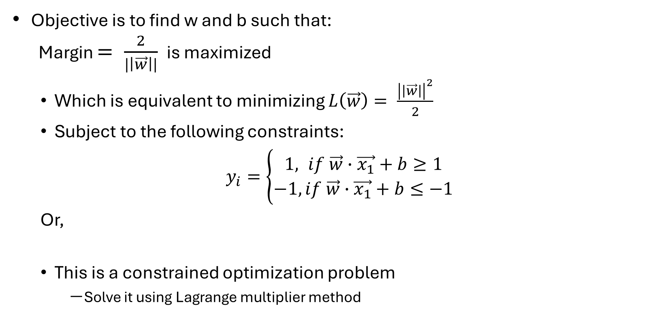
The Linearly Separable Case
Objective is to find w and b such that:
Margin $= \frac{2}{|\left|\vec{w}\right||}$ is maximized
Which is equivalent to minimizing $L\left(\vec{w}\right)= \frac{{\left|\left|\vec{w}\right|\right|}^{2}}{2}$
Subject to the following constraints:
$y_{i}=\left\{\begin{aligned}1, if \vec{w}∙\vec{x_{1}}+b≥1 \\ &−1,if \vec{w}∙\vec{x_{1}}+b≤−1\end{aligned}\right.$
Or,
This is a constrained optimization problem
Solve it using Lagrange multiplier method
$$y_{i}(\overset{⃑}{w}•\overset{⃑}{x_{i}}+b)≥1, i=1,2,...,N$$

Slide 15
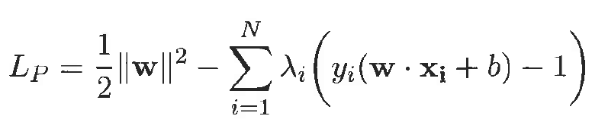
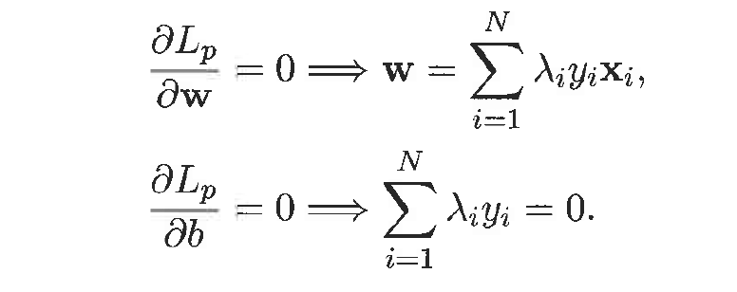
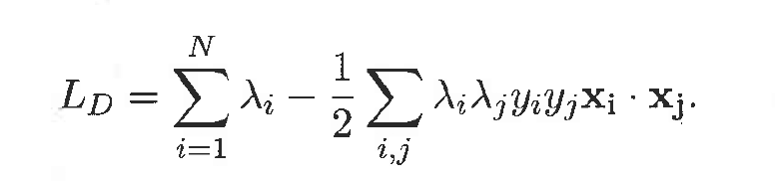

Solving the Optimization Problem
Need to optimize a quadratic function subject to linear constraints.
Quadratic optimization problems are a well-known class of mathematical programming problems for which several (non-trivial) algorithms exist.
The solution involves constructing a dual problem where a Lagrange multiplier $λ$_{i} is associated with every inequality constraint in the primal (original) problem
Notes:
The dual optimization problem can be solved using numerical techniques such as quadratic programming.

Slide 16
Example of Linear SVM
Support vectors

Slide 17
Support Vector Machines
What if the problem is not linearly separable?

Slide 18
Soft Margin Approach
What if the problem is not linearly separable?
Introduce slack variables
Need to minimize:
Subject to:
Parameter C can be viewed as a way to control overfitting: it “trades off” the relative importance of maximizing the margin and fitting the training data.
Notes:
Trade-off between the width of the margin and the number of training errors committed by the linear decision boundary.
Parameter c and k are user specified parameters representing the penalty of misclassifying the training instance.

Slide 19
Soft Margin Classification
The old formulation:
Modified formulation incorporates slack variables:
Parameter C can be viewed as a way to control overfitting: it “trades off” the relative importance of maximizing the margin and fitting the training data.
Find w and b such that
Φ(w) =w^{T}w is minimized
and for all (x_{i} ,y_{i}), i=1..n : y_{i} (w^{T}x_{i} + b) ≥ 1
Find w and b such that
Φ(w) =w^{T}w + CΣξ_{i} is minimized
and for all (x_{i} ,y_{i}), i=1..n : y_{i} (w^{T}x_{i} + b) ≥ 1 – ξ_{i,} , ξ_{i} ≥ 0

Slide 20


Non-Linear SVMs: Feature Spaces
General idea: the original feature space can always be mapped to some higher-dimensional feature space where the training set is separable:
$$（x_{1}, x_{2})$$
$$（x_{1}^{2}, x_{2}^{2}, √2x_{1}x_{2})$$
Φ: x → φ(x)
Notes:
Idea:
Add a magic dimension.
If we do not have the nonlinear algorithm, that’s fine, we reshape the data.
Example: prision
Problem: curse of dimensionality, learning parameters is hard (exponentailly)
Solutions: Kernal use the bless of the dimensionality but get rid of the curse

Slide 21
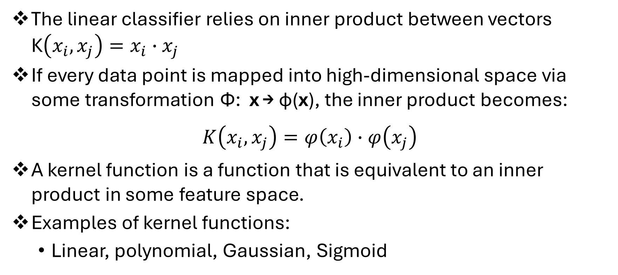
The “Kernel Trick”
The linear classifier relies on inner product between vectors K$\left(x_{i},x_{j}\right)=x_{i}∙x_{j}$
If every data point is mapped into high-dimensional space via some transformation Φ: x → φ(x), the inner product becomes:
$$K\left(x_{i},x_{j}\right)=φ\left(x_{i}\right)∙φ\left(x_{j}\right)$$
A kernel function is a function that is equivalent to an inner product in some feature space.
Examples of kernel functions:
Linear, polynomial, Gaussian, Sigmoid
Notes:
If I know this is a kernel function, I know there exist a Phi
The kernel function if you apply that function to the original set of data is the same as applying some phi function to the points and then compute the doc production.
Mercer theorem

Slide 22
Kernels
Why use kernels?
Do not have to know the exact form of the mapping function φ(x)
Computing using kernel functions is considerable cheaper
Avoid curse of dimensionality
Common kernels
Linear: K(x_{i},x_{j})= x_{i}^{T}x_{j}
Mapping Φ: x → φ(x), where φ(x) is x itself
Polynomial of power p: K(x_{i},x_{j})= (1+ x_{i}^{T}x_{j})^{p}
Mapping Φ: x → φ(x), where φ(x) has dimensions
Gaussian (radial-basis function): K(x_{i},x_{j}) =
Mapping Φ: x → φ(x), where every point is mapped to a function (a Gaussian); combination of functions for support vectors is the separator.
Notes:
Kernels help to address some of the concerns about how to implement nonlinear SVM.
* mercer’s theorem: ensures that the kernel functions can always be expressed as the dot product between two input vectors in some high-dimensional space.

Slide 23
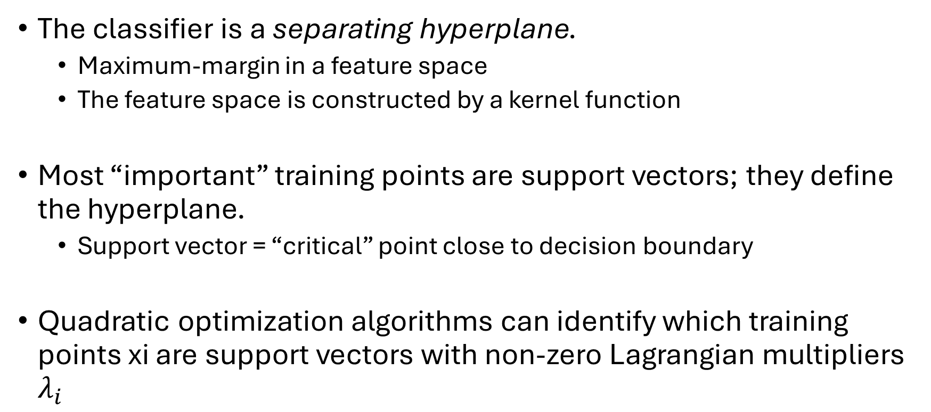
SVM Summary
The classifier is a separating hyperplane.
Maximum-margin in a feature space
The feature space is constructed by a kernel function
Most “important” training points are support vectors; they define the hyperplane.
Support vector = “critical” point close to decision boundary
Quadratic optimization algorithms can identify which training points xi are support vectors with non-zero Lagrangian multipliers $λ_{i}$

Slide 24
SVM Applications
SVMs are currently among the best performers for several classification tasks ranging from text to genomic data.
SVMs can be applied to complex data types beyond feature vectors (e.g., graphs, sequences, relational data) by designing kernel functions for such data.
SVM techniques have been extended to several tasks such as regression [Vapnik et al. ’97], principal component analysis [Schölkopf et al. ’99], etc.
Tuning SVMs remains a black art: selecting a specific kernel and parameters is usually done in a try-and-see manner.
Select Kernel function and related parameters
E.g., Gamma for a Gaussian Kernel
Select cost parameter, c, to control soft margin

Slide 25
Advantages of SVM
Finds a global, unique minimum.
The kernel trick.
A simple geometric interpretation.
Strong ability to generalize.
Less sensitive to outliners
The complexity of the calculations does not depend on the dimension of the input space
Avoids the curse of dimensionality

Slide 26
Disadvantages of SVM
Which kernel function?
How to select the parameters of the kernel function?

